Slide 1
Hardware Testing part 2(Group 5)
Submitted by: Gurman singh(Co753359)

Slide 2
About the project
In a gesture keyboard in which words are typed in air, that are displayed in PC/laptop. The components used are Arduino board, Bluetooth module, Gyroscope and PC/laptop. The machine learning algorithm "Supervised learning" is used with some predictions along with designed project to detect the alphabet. The whole project or design is controlled by Beaglebone black. The project's main aim is to detect the letters by hand in air should be recognized and displayed on the PC/laptop. The gyroscope is attached to hand, so when letters are written in air, through Bluetooth module, the data is transferred to the laptop where they are displayed.

Slide 3
Limitations of the older system:
Very Limited Processing Power available.
Arduino is a very low power microcontroller.
External Bluetooth makes it bulky.
Less Accuracy due to more physical connections.
No Pause system to stop sending data when needed.

Slide 4
List of hardware components
Beaglebone Black
Gyroscope sensor
Voltage regulator Wifi module
Lithium ion battery for power supply
LCD display
Arduino UNO
RF 315/433 MHZ

Slide 5
Function of each component
Beaglebone Black:The Beaglebone is a low-power open-source single-board computer produced by Texas Instruments in association with Digi-Key and Newark element14. The operating voltage is 5V. The board uses up to 2 W of power and can be powered from the USB connector, or a separate 5 V power supply. Built-in storage and memory are provided through a pop chip that includes 256 MB of NAND flash memory and 256 MB of RAM (128 MB on earlier models).
Gyroscope sensor – MPU6050The MPU-6050 devices combine a 3-axis gyroscope and a 3-axis accelerometer on the same silicon die, together with an onboard Digital Motion Processor™ (DMP™), which processes complex 6-axis Motion Fusion algorithms. The devices are offered in a 4 mm x 4 mm x 0.9 mm QFN package

Slide 6
Wi-Fi module – USB Adapter A USB Wi-Fi adapter overrides the computer's built-in wireless functionality, giving you a faster, more reliable connection to your available network signals through the USB port instead. Since most computers have at least one USB port, you’ll typically be able to use it on both laptops and desktops. Plus, the plug-and-play convenience means you can remove the device when it's not needed to use in another computer. RF 315/433 MHZ transmitter-Receiver The RX – ASK is an ASK Hybrid receiver module. It is an effective low-cost solution for using 433 MHz the TX-ASK is an ASK hybrid transmitter module. TX-ASK is designed with an effective low cost, small size and simple to use for designing. Voltage Regulator – LM2596 Module LM2596 Power Supply is a step-down switching regulator, capable of driving a 3-A load with excellent line and load regulation.A voltage regulator is a system designed to automatically maintain a constant voltage level. A voltage regulator may use a simple feed-forward design or may include negative feedback. It may use an electromechanical mechanism, or electronic components. Depending on the design, it may be used to regulate one or more AC or DC voltages.

Slide 7
Lithium ion battery – 3 cell li-ion battery A lithium-ion battery or Li-ion battery is a type of rechargeable battery. Lithium-ion batteries are commonly used for portable electronics and electric vehicles. LCD Display – 16x2 LCD i2c based An LCD (Liquid Crystal Display) screen is an electronic display module. A 16x2 LCD display is very basic module and is very commonly used in various devices and circuits. A 16x2 LCD means it can display 16 characters per line and there are 2 such lines. Arduino UNO – Arduino Uno The Arduino Uno is an open-source microcontroller board based on the Microchip ATmega328P microcontroller and developed by Arduino.cc. The board is equipped with sets of digital and analog input/output pins that may be interfaced to various expansion boards and other circuits. Microcontroller: ATmega328P Operating Voltage: 5V

Slide 8
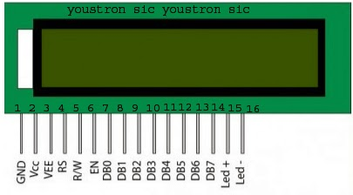
Testing of LCD
FOLLOW THESE STEPS :
Connect the pin vcc pin to 5v
Connect pin Vee and gnd pin to ground
Connect Led+ to 5v
Connect led- pin to ground

Slide 9
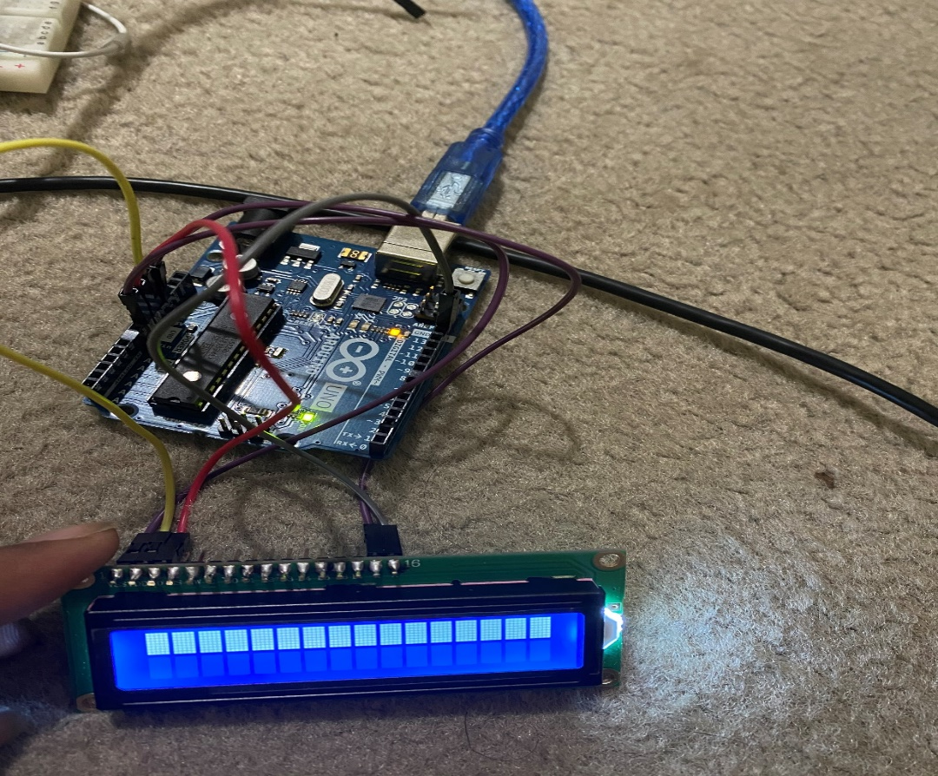
If the LCD is working properly then only one line will be brighten If both the lines are brighten then our LCD will not working properly

Slide 10
Testing of 315/433Mhz RF module
Materials required :315/433 Mhz RF module
7805 voltage regulator
330 ohm resisitor
Orange led diode
5v battery
In this , 5volt input supply will be given to 7805 voltage regulator. The function of 7805 voltage regulator is to maintain that 5 voltage on its ouput. Then that 5volt supply is send to the 315mhz transmitter part which further perform its function and on receiver side across 433mhz two parallel connection are done in both 330ohm resistor is connected to orange LED diode

Slide 11
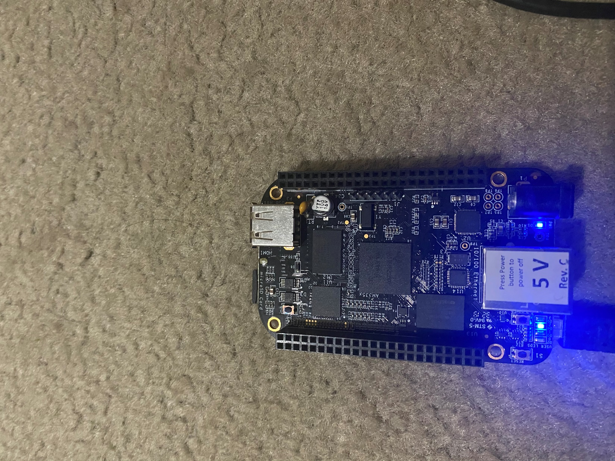
Testing of beaglebone black
Materials required:USB cable to connect to PC,beaglebone black
In the testing of beaglebone black ,beaglebone black is just connected to the linux and terminal command 192.168.7.2 is used. Once we done that then it shows debian@beaglebone.local is found which means that beaglebone black is successfully attached to the linux. After that linux demands password of beaglebone black which is temppwd.Beaglebone will give response once we put any code in it

Slide 12
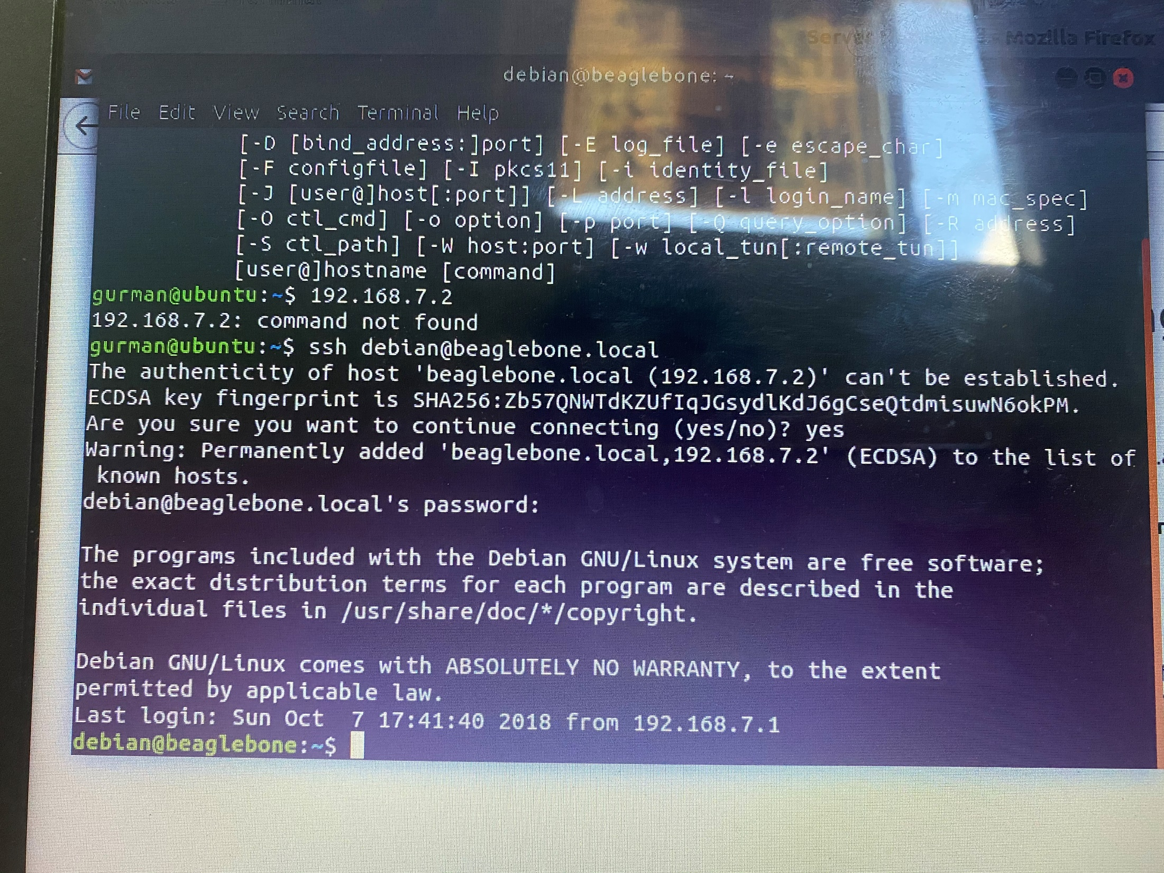

Slide 13
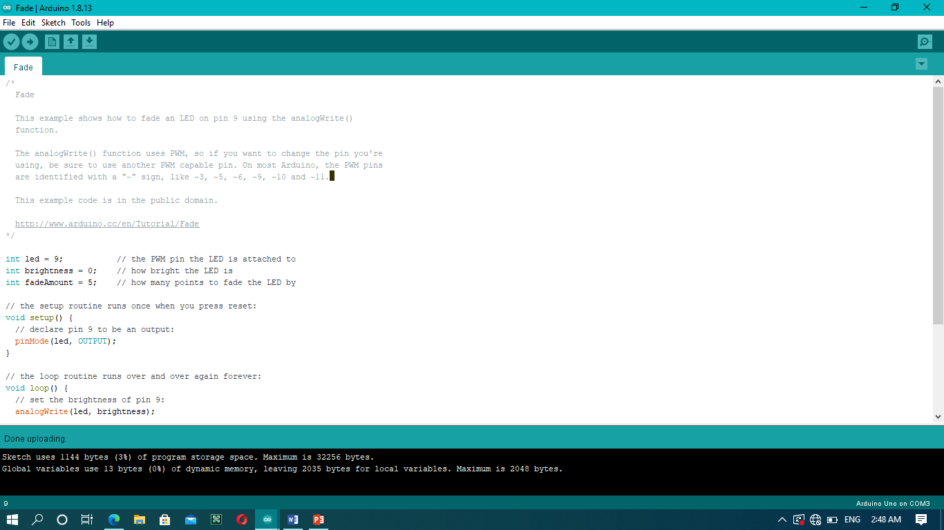
Testing of Arduino UNO
Material required: Arduino UNO chip,USB cable,laptop.
In this Arduino UNO is connected to Arduino IDE. For testing the Arduino UNO we need to compile any code and upload on the Arduino UNO chip. For this we have selected fade code in which LED will glow steadly.

Slide 14
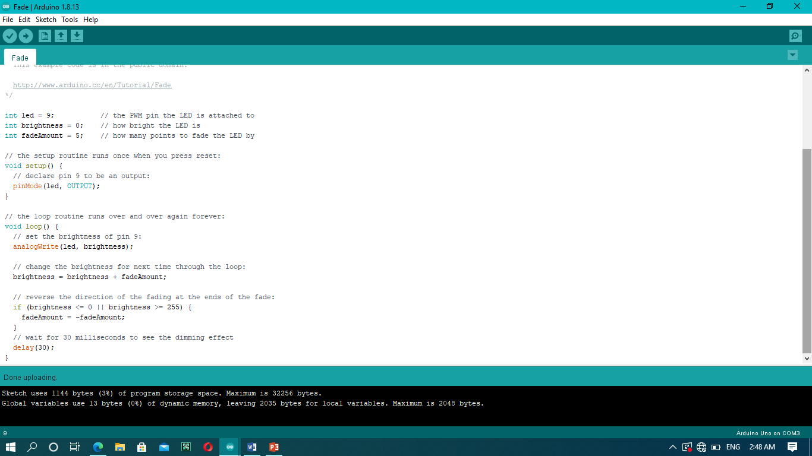

Slide 15
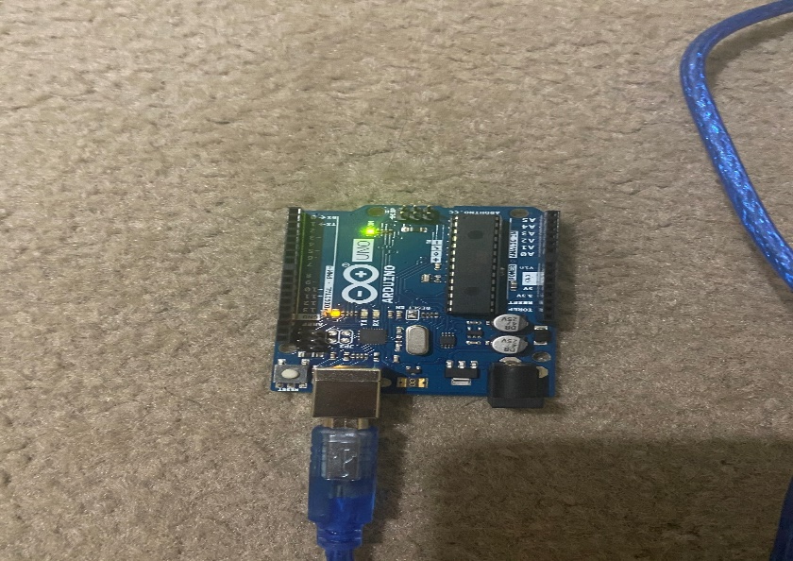

Slide 16
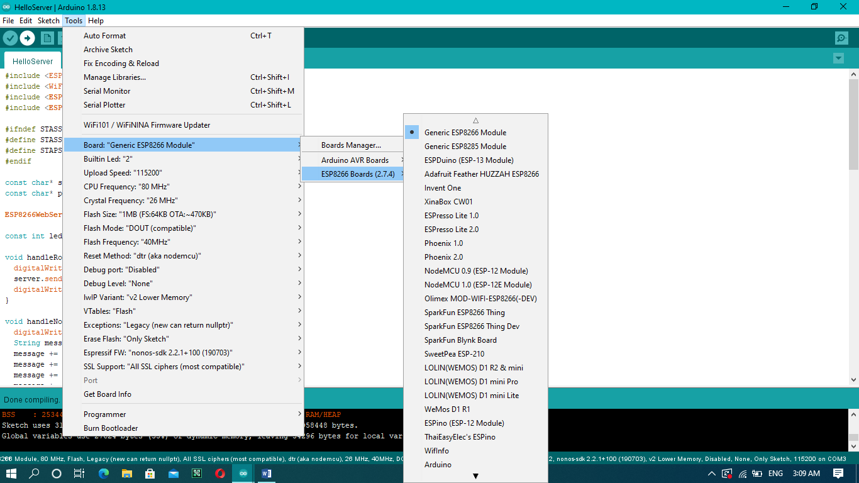
Testing of wifi module
Material required: ESPwifi8266, USB cable connecting wires

Slide 17
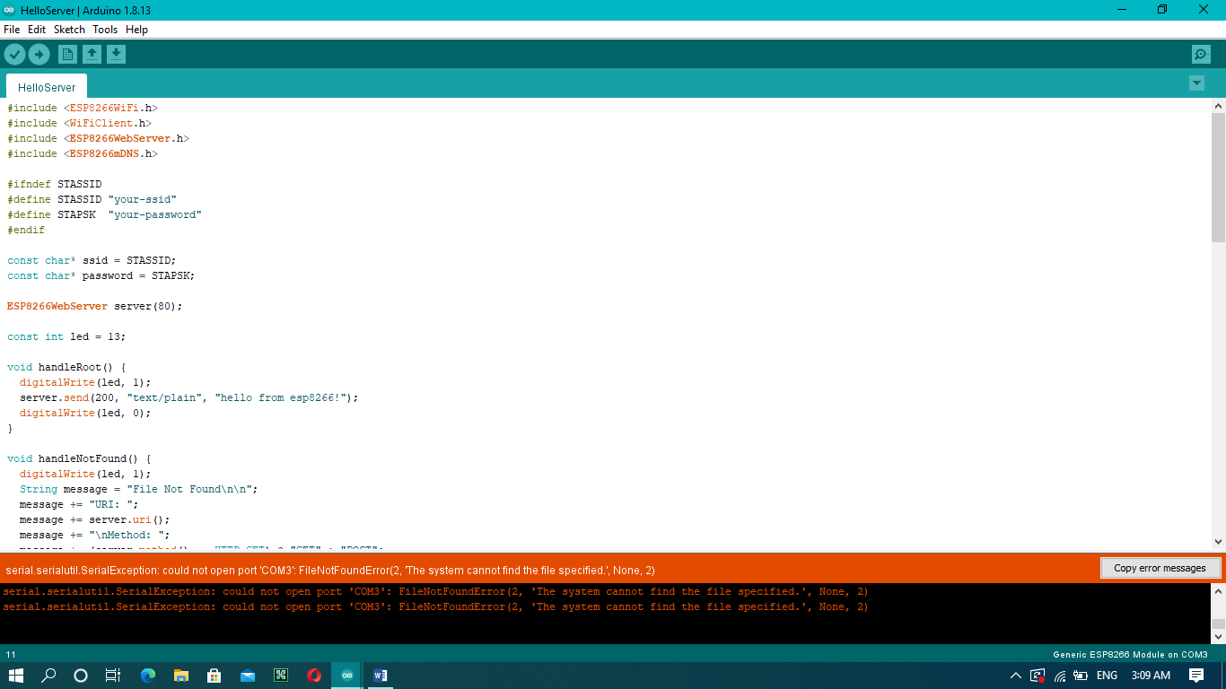

Slide 18
References
https://piratelearner.com/en/bookmarks/how-to-check-whether-16x2-lcd-working-or-not/16/
https://youtu.be/Z6YwcGjw6ps
https://maker.pro/arduino/tutorial/how-to-interface-arduino-and-the-mpu-6050-sensor
https://dzone.com/articles/programming-the-esp8266-with-the-arduino-ide-in-3
https://www.youtube.com/watch?v=TnWDlHpY56o

